Slide 1
React Using Requests Objects In Fullstack
D VINAY
22H51A0578
CSE-D

Slide 2

Introduction to Fullstack Development
Fullstack development involves both frontend and backend technologies working together.
React is a popular library for building user interfaces on the frontend.
Understanding request objects is crucial for effective data handling in fullstack applications.
Notes:
Image source: https://codup.co/full-stack-development-a-short-guide-to-get-you-started/

Slide 3
What are Request Objects?
Request objects represent the HTTP request made by a client to a server.
They encapsulate the client's input, including query parameters, headers, and body data.
In the context of React, request objects are essential for fetching and sending data to APIs.
Notes:
Image source: https://www.linkedin.com/pulse/sending-http-requests-connecting-database-smriti-pradhan

Slide 4
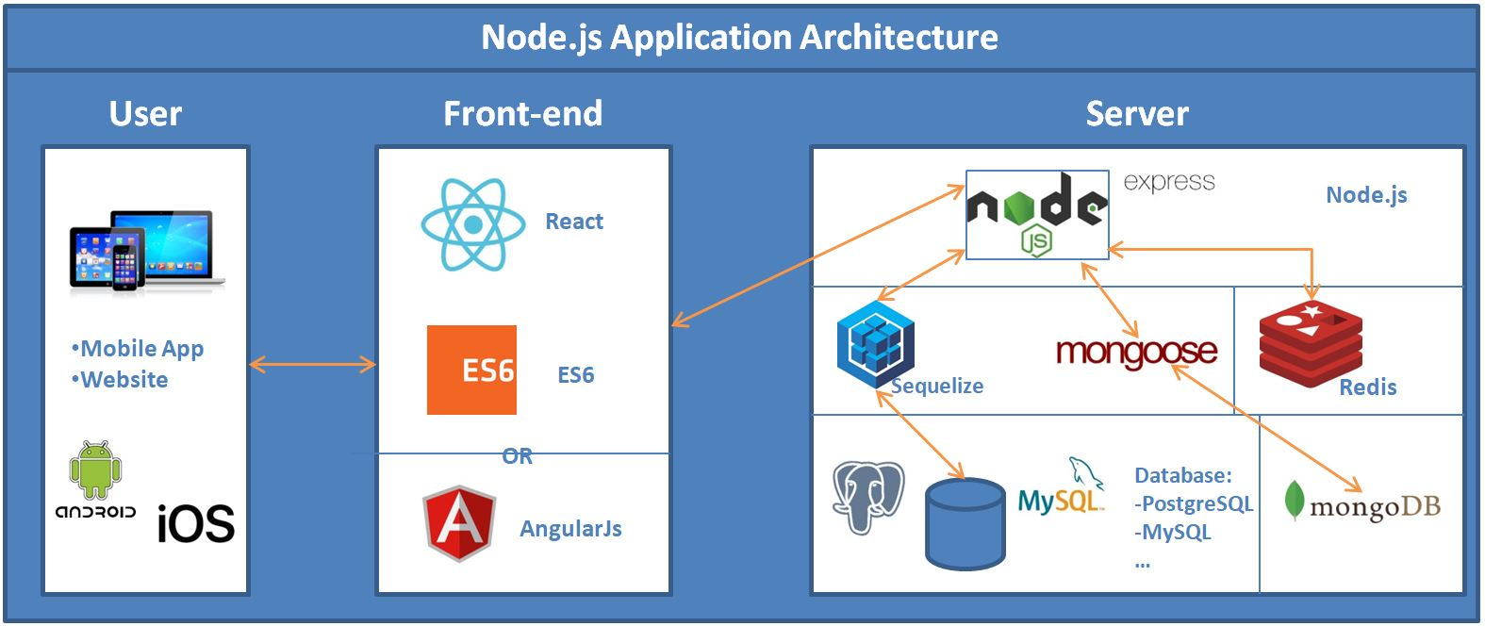
Setting Up a Fullstack Environment
A typical fullstack environment includes a React frontend and a Node.js/Express backend.
We can use tools like Create React App for setting up the frontend quickly.
The backend can be set up using Express to handle request objects effectively.
Notes:
Image source: https://cefwnrzz.blob.core.windows.net/react-js-standard-project-structure.html

Slide 5
Making GET Requests in React
GET requests retrieve data from a server without altering its state.
In React, we can use the Fetch API or libraries like Axios to handle GET requests.
Properly managing responses ensures that the UI stays in sync with the backend data.
Notes:
Image source: https://www.freecodecamp.org/news/how-to-use-axios-with-react/

Slide 6

Handling POST Requests in React
POST requests are used to send data to the server to create or update resources.
React can send POST requests using the same Fetch API or Axios, including body data.
Managing the response from POST requests helps in updating the frontend state effectively.
Notes:
Image source: https://meijer.ws/articles/handling-post-requests-in-next-js-getserversideprops

Slide 7
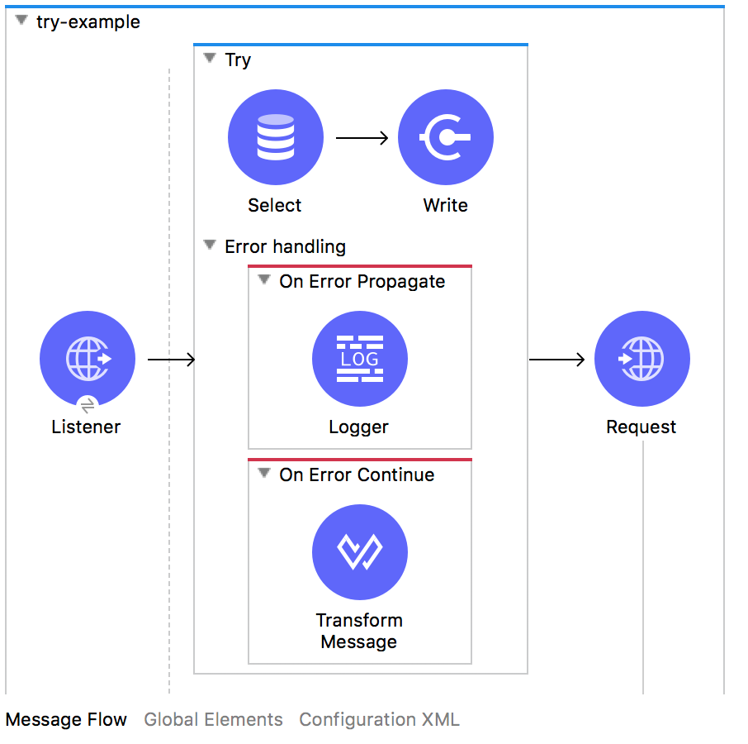
Error Handling for Requests
Error handling is essential when making requests to provide a better user experience.
We can implement try-catch blocks or .catch methods to handle errors in asynchronous code.
Displaying user-friendly error messages improves the overall usability of the application.
Notes:
Image source: http://expertmiddleware.unaux.com/understanding-error-handling-in-mulesoft-mule-4/

Slide 8
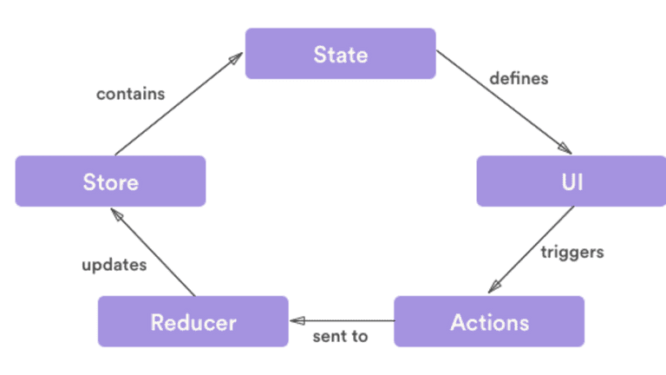
State Management with Request Responses
Managing state in React is vital for reflecting changes from request responses.
Libraries like Redux or the Context API can help manage global state in an application.
Updating the state based on request results ensures a responsive and dynamic UI.
Notes:
Image source: https://www.loginradius.com/blog/engineering/react-state-management/

Slide 9
Example:
import React, { useState, useEffect } from 'react';
const FetchRequestExample = () => {
const [data, setData] = useState(null);
useEffect(() => {
fetch('https://jsonplaceholder.typicode.com/posts/1')
.then(response => response.json())
.then(json => setData(json))
.catch(err => console.error('Error:', err));
}, []);
return (
<div>
<h1>Fetch Request Example</h1>
{data ? (
<div>
<h2>{data.title}</h2>
<p>{data.body}</p>
</div>
) : (
<p>Loading...</p>
)}
</div>
);
};
export default FetchRequestExample;

Slide 10
THANK YOU

